Slide 1
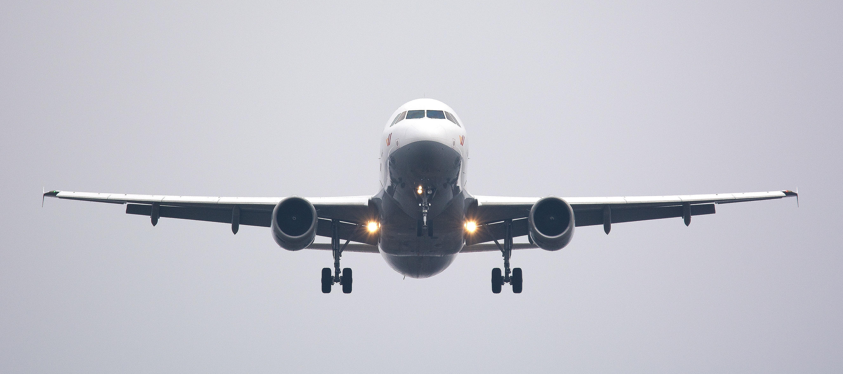
Elevating Excellence: Enhancing Quality, Sales, and Satisfaction in United Airlines' Food and Beverage Services"

Slide 2
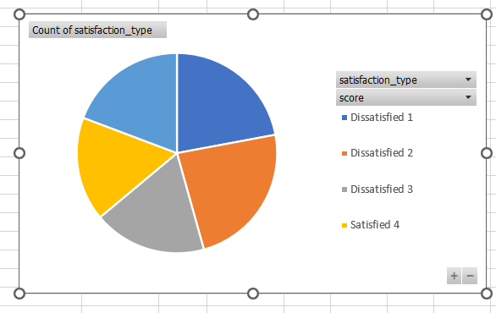
F & b satisfaction calculation and business model
Understanding the model
Inflight Satisfaction score:
% Inflight Satisfaction = Satisfied Sample/Total Sample*100
=(12610/47074)*100=26.78%
Customer segment
Users who want to get their favourite food at airport
Users who are diet conscious can get healthy food deliver at airports
Value proposition
ALTERING MEALS ACCORDING TO CUSTOMER SPECIFICATIONS
BEST INFLIGHT MEAL SERVICES AT UMATCHED QUALITY
How united airlines aligns with the f & b satisfaction
Provides convenient and reliable solution for high quality and healthy food options.
Customers can prebook their meal even at small hauls
Delivery should be faster
Including the price of food within the ticket by increasing the price by 2-3% of the ticket
Cost structure
Including the price of food within the flight tickets to make it look cheap
For example: a flight ticket of $200 can be increased to $210 along with food offering
Revenue streams
Commissions and affiliate income
Including advertisements on app to increase revenue generation
Key partners
global & regional vendors
Key resources
global & regional vendors
technology
Customer relationships
Social media pages customer chat support Feedback systems
channels
Mobile application
Digital marketing
Advertisements

Slide 3
USER RESEARCH AND NEEDS OF THE TARGET USER SEGMENT
Satisfaction : not satisfied
Question: Is there anything you'd like to share about the food & beverage served on your flight from [CITY] to [CITY]?
User1:Aeroplane food sucks. But I am not sure how to fix . I suspect you are doing your best.
User2:Food needs to improve big time. 10-20 years ago was much better.
User3:You could do a lot better, your food is edible but just that, you are far from having the WOW factor.
User4:Beverages were only offered at the beginning of the flight and at the end. Granted, it was likely not to disturb sleeping patrons however, for a 9 hour flight, there should have been more.
User5:Again the choices were limited and not all were available- for a paying customer this is always disappointing.
Satisfaction : barely satisfied
Question: Is there anything you'd like to share about the food & beverage served on your flight from [CITY] to [CITY]?
User1:Zurich to Chicago food was good. I was told there were no more business class vegetarian options and would have to get a meal from the economy class. Why are there not more vegetarian dishes available on flights?. Why can not we pre-designate dietary restrictions on the app or put in permanent dietary preferences online?. In addition, the food from Washington DC to Zurich was horrendously bad inedible.
User2:I was in Business Class. food was fine, but not nearly as good as in Business Class on Singapore Air.
USERS INTERVIEW
USERS INTERVIEW
Pain points
Food quality
Less food and beverages offering
Limited choices
Unhygienic food
Salad is not offered
Food doesn’t look good
Needs
Improved food quality
Beverages should be offered at regular intervals of 1-2 hours
Food choices should be increased
Salad should be offered
Customization of food
Pain points
Dietary preferences are not available
non availability of veg food
Limited choices
Food quality
Needs
Dietary preferences should be available on app
Availability of veg food
Choices should be increased
Food quality should be increased along with packaging

Slide 4
Breaking down the problem
WHY THIS SOLUTION?
When I open app to prebook my meal I am craving for healthy food with some salad
But I can’t always find and order healthy food and beverages. I also can’t find vegetarian food and some are only listed on the apps and aren’t available while ordering them.
Help me get a proper healthy meal while traveling with some desert , salad healthy beverages at a decent price point.
JBTD FRAMEWORK
Meals from unauthenticated restraunts and fast food is not good for health.
Unavailability of veg foods
Users have to hassle of deciding and ordering food
Large percentage of customers need healthy food and healthy drinks
Increase in DAU, revenue through subscription, #partner restaurants/home chefs, #orders, delivery charges
Subscription model
Pre-scheduled delivery
Food from verified vendors
Pain points
Dietary preferences are not available
non availability of veg food
Limited choices
Food quality
Needs
Dietary preferences should be available on app
Availability of veg food
Choices should be increased
Food quality should be increased along with packaging

Slide 5
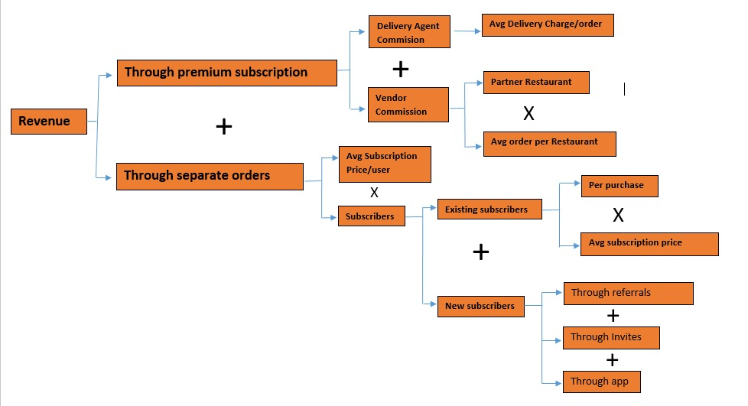
Breaking down the problem

Slide 6
IDEATING THE SOLUTION FROM AN ALL ACTORS PERSPECTIVE
Solution Introduction
Impact:
Solution:
It addresses the users pain points and increases customer satisfaction and differentiates united airlines from others. Authentication of vendors makes sure that customer gets healthy and good quality of food.
The premium feature attracts the users as they get coupons with which they can purchase food.
Introducing premium membership for the customers the target audience will be who travel at regular intervals and offering them with coupons that can be used to buy food and beverages, premium membership allowing customer to order food even in flight at same discount as shown during the purchasing of ticket.
Slightly Increasing the price of Ticket by 2-3% and including the food and beverages within that flight.
Increasing global vendors count by properly authenticating their food
Not to sell the expiry food on airports
Availability of veg food should be increased
Food which is available should be updated on the app and the unavailable food should be disappeared from the list
Allow people to order the food at slightly less discount as shown during the purchase of ticket. For eg:
Discount during purchase of ticket was 35% then during flight it should be given around 20-15% not zero
All Actors Perspective and Needs
Investors
Witness sustainable growth, profitability, and innovation through “Premium” and authentication which addresses customer pain points and contributes to the company's success
Delivery Partners
Experience consistent demand for deliveries, ensuring stable income and opportunities for maximizing earnings
Customers and premium as platform
Enjoy convenient, healthier, and time-saving meals with automated
deliveries, addressing their need.
Enhance customer satisfaction, increase user retention

Slide 7
USER FLOW FOR PREMIUM MEMBERSHIP
INTRO
STEP1
SELECT CATEGORY
VEG
NON VEG
VIEW MENU
REEDEM COUPONS
FEEDBACK
FAST FOOD
HEALTHY FOOD
PLACE ORDER
ORDER DELIEVERD
ORDER DELIEVERD
SELECT
YES

Slide 8
USER FLOW FOR NON PREMIUM MEMBERS
INTRO
STEP1
FOR Eg:
IF DISCOUNT ON PREBOOK IS 35% THEN DURNG FLIGHT IT SHOULD BE PROVIDED AS 20-15% NOT ZERO IT WILL INCREASE THE REVENUE
SELECT CATEGORY
VEG
NON VEG
FEEDBACK
VIEW MENU
FAST FOOD
HEALTHY FOOD
PLACE ORDER
ORDER DELIEVERD
ORDER DELIEVERD
SELECT
YES

Slide 9
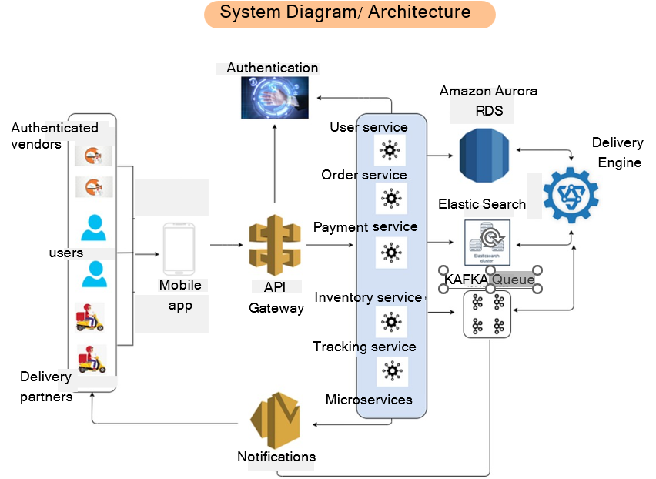
METRICES AND SYSTEM DIAGRAM
METRICES TO TRACK SUCCESS
User Adoption and Subscriptions
# new subscribers Subscriber growth rate
Churn rate: %age of cancellation RPR : Repeat Purchase Ratio
User Engagement and Retention Daily active users (DAU) & monthly active users (MAU)
Avg #meals per subscriber per month Retention rate: %age of renewal(assuming: the premium will be purchased by regular businessman who travel at most 2 times in a month
Revenue Metrics
Average revenue per user (ARPU) Monthly recurring revenue (MRR) from subscriptions.
User Feedback and Satisfaction Customer satisfaction score (CSAT) through post-order surveys.
Net Promoter Score (NPS)

Slide 10
SCOPE OF MVP VERSION AND POTENTIAL RISKS WITH MITIGATIONS
Scope of MVP and What next?
Potential Risks
User Adoption: Some Users may not be willing to commit to long-term subscriptions or may prefer the flexibility of on-demand ordering.
Quality Control and Consistency : Ensuring consistent meal quality and maintaining quality standards across various cuisines is crucial to avoid negative user experiences.
Operational Complexity : Managing the logistics of automated meal deliveries on a large scale requires a robust and efficient operational setup. Delivery timing, routing, and coordination with vendors are critical factors.
Food wastage : Users may also tend
to forget the delivery leading to wastage of food.
Flexible subscription plan for users
Hybrid model with on demand options
The scope of MVP version includes the following features that can be introduced in further versions:
Meal Selection and Customization : Provide a curated menu of healthy meals for users to choose from. Allow users to customize their meal preferences, dietary requirements, and any optional add-ons.
Bundled Meal Plans : Introduce bundled meal plans for families or group subscriptions, encouraging higher-value purchases and maximizing revenue potential.
Upselling and Add-Ons The new version of app with premium can offer optional add-ons or complementary products to subscribers, generating additional revenue through upselling.
AI-Powered Meal Recommendations: Implement artificial intelligence algorithms to analyze user preferences and ordering patterns. Offer personalized meal recommendations based on user tastes, dietary requirements, and past orders.
Customer feedback loop
Periodic Audits
Optimize delivery time
Transparent communication with vendors and delivery agents
Customer feedback loop
Periodic Audits
Real time notifications & alert before delivery
Enable users to reschedule

Slide 11
SUMMARY
Providing discounts on ordering even on flights
Providing a premium membership offer to all people allowing them to claim coupons after completing the flight
Authenticating the vendors providing foods as per standard
Making sure the availability of veg food
The food which is not available should be disappeared from the menu by the vendors side
Beverages should be offered at regular intervals of time and should be included within the flight charges
Non alcoholic beer should be made available for the users
Charges of flight should be increased slightly by 2-3% and one time food should be made available in it
Made by-
Dheeraj Baghel
Netaji Subhas University of Technology

